Slide 1


Enterprise Scale

Slide 2

What is Enterprise Scale
Enterprise-Scale architecture represents the strategic design path and target technical state for the customer's Azure environment
Notes:
The Enterprise-Scale architecture represents the strategic design path and target technical state for the customer's Azure environment. It will continue to evolve in lockstep with the Azure platform and is ultimately defined by the various design decisions the customer organization must make to define their Azure journey.
It is important to highlight that not all enterprises adopt Azure in the same way, and as a result the Enterprise-Scale architecture may vary between customers. Ultimately, the technical considerations and design recommendations presented within this playbook may yield different trade-offs based on the customer scenario. Some variation is therefore expected, but provided core recommendations are followed, the resultant target architecture will position the customer on a path to sustainable scale.

Slide 3
Landing Zones
Within the context of the Enterprise-Scale architecture, a "Landing Zone" is a logical construct capturing everything that must be true to enable application migrations and development at an Enterprise-Scale in Azure. It considers all platform Resources that are required to support the customer's application portfolio and does not differentiate between IaaS or PaaS.
Notes:
Landing Zones Definition
Within the context of the Enterprise-Scale architecture, a "Landing Zone" is a logical construct capturing everything that must be true to enable application migrations and development at an Enterprise-Scale in Azure. It considers all platform Resources that are required to support the customer's application portfolio and does not differentiate between IaaS or PaaS.
Every large enterprise software estate will encompass a myriad of application archetypes and each Landing Zone essentially represents the common elements, such as networking and IAM, that are shared across instances of these archetypes and must be in place to ensure that migrating applications have access to requisite components when deployed. Each Landing Zone must consequently be designed and deployed in accordance with the requirements of archetypes within the customer's application portfolio.
The principle purpose of the "Landing Zones" is therefore to ensure that when an application lands on Azure, the required "plumbing" is already in place, providing greater agility and compliance with enterprise security and governance requirements.
Using an analogy, this is similar to how city utilities such as water, gas, and electricity are accessible before new houses are constructed. In this context, the network, IAM, policies, management, and monitoring are shared 'utility' services that must be readily available to help streamline the application migration process.

Slide 4
Design principles
Subscription democratization
Policy-driven governance
Single control and management plane
Application-centric and archetype-neutral
Aligning Azure-native design and road maps
Notes:
Subscription democratization
Utilize subscriptions as a unit of management and scale to accelerate application migrations and new application development. Align subscriptions with business needs and priorities to support business areas and portfolio owners. Subscriptions should be provided to business units to support the design, development, and testing of new workloads and migration of existing workloads.
To enable the organization to operate effectively at scale, support a subscription with suitable Management Group hierarchy. This will allow the subscription to be managed and organized efficiently.
Policy-driven governance
Use Azure Policy to provide guardrails and ensure continued compliance with your organization's platform and the applications deployed onto it. Azure Policy also provides application owners with independence and a secure, unhindered path to the cloud.
Single control and management plane
Avoid dependency on abstraction layers, such as customer-developed portals or tooling. Having a consistent experience for both Central Operations and Workload Operations is highly recommended. Azure provides a unified and consistent control plane which is subject to role-based access and policy-driven controls. This applies across all Azure resources and provisioning channels. Azure can be used to establish a standardized set of policies and controls for governing the entire enterprise estate.
Application-centric service model
Focus on application-centric migrations and development rather than pure infrastructure lift-and-shift migrations, such as moving virtual machines. The design choices shouldn't differentiate between old and new applications, infrastructure as a service (IaaS), or platform as a service (PaaS) applications.
Regardless of the service model, strive to provide a secure environment for all applications deployed on the Azure platform.
Align with Azure-native design and roadmaps
Leverage Azure-native platform services and capabilities whenever possible. This approach should align with Azure platform roadmaps to ensure that new capabilities are available within your environments. Azure platform roadmaps should help to inform the migration strategy and the Azure landing zone conceptual trajectory.

Slide 5
Design principles
Subscription democratization
Policy-driven governance
Single control and management plane
Application-centric and archetype-neutral
Aligning Azure-native design and road maps
Notes:
Subscription democratization
Utilize subscriptions as a unit of management and scale to accelerate application migrations and new application development. Align subscriptions with business needs and priorities to support business areas and portfolio owners. Subscriptions should be provided to business units to support the design, development, and testing of new workloads and migration of existing workloads.
To enable the organization to operate effectively at scale, support a subscription with suitable Management Group hierarchy. This will allow the subscription to be managed and organized efficiently.
Policy-driven governance
Use Azure Policy to provide guardrails and ensure continued compliance with your organization's platform and the applications deployed onto it. Azure Policy also provides application owners with independence and a secure, unhindered path to the cloud.
Single control and management plane
Avoid dependency on abstraction layers, such as customer-developed portals or tooling. Having a consistent experience for both Central Operations and Workload Operations is highly recommended. Azure provides a unified and consistent control plane which is subject to role-based access and policy-driven controls. This applies across all Azure resources and provisioning channels. Azure can be used to establish a standardized set of policies and controls for governing the entire enterprise estate.
Application-centric service model
Focus on application-centric migrations and development rather than pure infrastructure lift-and-shift migrations, such as moving virtual machines. The design choices shouldn't differentiate between old and new applications, infrastructure as a service (IaaS), or platform as a service (PaaS) applications.
Regardless of the service model, strive to provide a secure environment for all applications deployed on the Azure platform.
Align with Azure-native design and roadmaps
Leverage Azure-native platform services and capabilities whenever possible. This approach should align with Azure platform roadmaps to ensure that new capabilities are available within your environments. Azure platform roadmaps should help to inform the migration strategy and the Azure landing zone conceptual trajectory.

Slide 6
Critical design areas
The eight critical design areas are intended to support the translation of customer requirements to Azure constructs and capabilities, to address the mismatch between on-premises infrastructure and cloud-design which typically creates dissonance and friction with respect to the Enterprise-Scale definition and Azure adoption.
Billing and Active Directory tenants
Identity and access management
Network topology and connectivity
Resource organization
Security
Management
Governance
Platform automation and DevOps
Notes:
Critical Design Areas
The eight critical design areas are intended to support the translation of customer requirements to Azure constructs and capabilities, to address the mismatch between on-premises infrastructure and cloud-design which typically creates dissonance and friction with respect to the Enterprise-Scale definition and Azure adoption.
Billing and Active Directory tenants
Identity and access management
Network topology and connectivity
Resource organization
Security
Management
Governance
Platform automation and DevOps

Slide 7
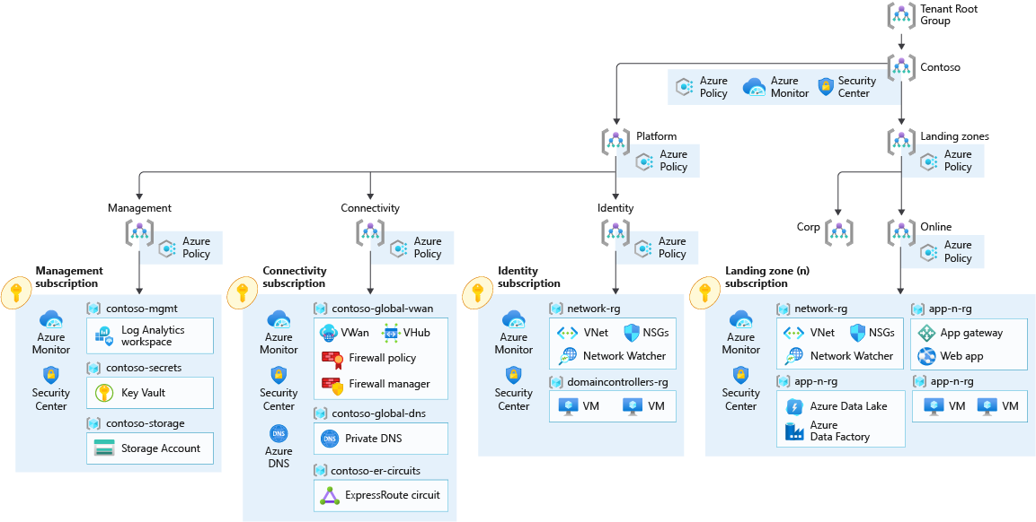
Notes:
The Enterprise-Scale architecture is modular by design and allows organizations to start with foundational landing zones that support their application portfolios and add hybrid connectivity with ExpressRoute or VPN when required. Alternatively, organizations can start with an Enterprise-Scale architecture based on an Azure Virtual WAN network topology if customers require hybrid connectivity to on-premises locations and global transit connectivity from the beginning.
Azure Virtual WAN is a Microsoft-managed solution that provides end-to-end, global, and dynamic transit connectivity by default. Virtual WAN hubs eliminate the need to manually configure network connectivity. For example, you don't need to manage user-defined routes (UDR) or network virtual appliances (NVAs) to enable global transit connectivity. Virtual WAN simplifies end-to-end network connectivity in Azure, and to Azure from on-premises, by creating a hub-and-spoke network architecture. The architecture can easily scale to support multiple Azure regions and on-premises locations (any-to-any connectivity) as shown in the following figure:

